Slide 1

Brittany
August
By August and Brittany
Composing Visual Documents

Slide 2
Is the following advertisement effective? If so, why?

Slide 3


Slide 4
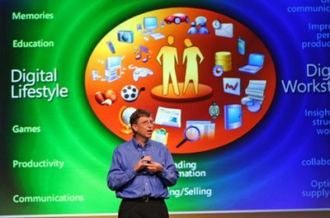
Visual Documents Today

Slide 5
Agenda
Provide the class with the tools/skills necessary to interpret and compose visual documents.
We will accomplish this by examining:
What makes a visual documents?
Why do we use visual documents?
How are visual documents effective?
Summary

Slide 6

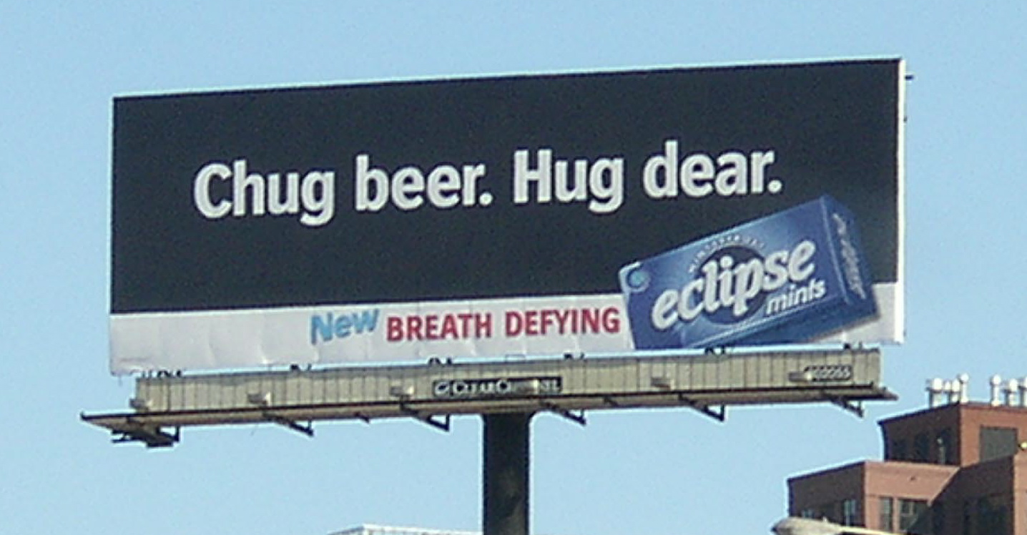
What are visual documents?
‘Visual documents combine are documents that combine visual elements, such as images or graphics, with verbal text to express meaning or deliver a message to an intended audience.’
Notes:
BLUF: Visual documents are diagrams, tables, photographs, posters, billboards, brochures, advertisements, newsletters, and Web sites.
Visual documents can be expressive, expository, and argumentative.
Visual documents are effective tools when used in appropriate situations.
Most posters, billboards, and advertisements use a small amount text so that the message can be conveyed and registered quickly.

Slide 7

The Rhetorical Situation
Different rhetorical strategies
Relationship between purpose and audience
Interpretation and composition
Notes:
Discussing the Rhetorical Situation
different genres of visual documents serve different purposes and therefore employ different rhetorical strategies
Expressive
Expository
Argumentative
“Just like the rhetorical analyses you have performed on text documents, analyses of visual documents must always account for the relationship between purpose and audience.” (131)
ads target broad audiences in “hopes to persuade potentially disinterested viewers”
brochures target “members of a specialized audience who are already predisposed to the message”
Ex. Educational consideration of audience, propaganda targeted at illiterate masses
Incorporates same elements for the interpretation and composition of verbal text:
Exigence
Sender
Audience
Purpose
Message
Context
August’s Notes: This slide is awesome.

Slide 8
Designing Visual Documents
Four basic principles:
Alignment
Proximity
Contrast
Repetition
Notes:
Designers structure visual documents in order to achieve coherence, develop ideas, and make a point. These aspects are parallel to the goals set while organizing words and sentences, thus there is a need for guidelines while composing visual documents.

Slide 9
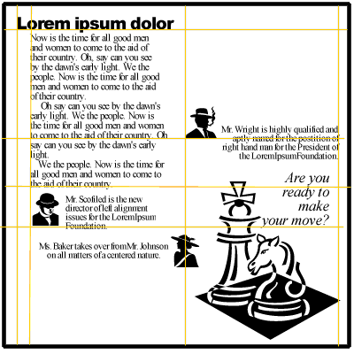
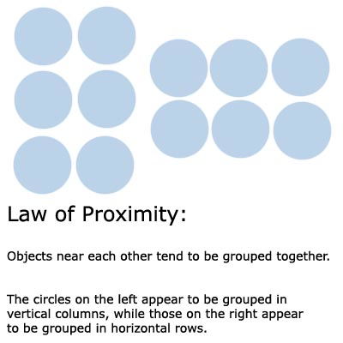


Designing Visual Documents
Alignment
Invisible Grid
Proximity
White Space
Notes:
The principle of alignment involves the use of an invisible grid system to place elements on a page. The lines run from top to bottom and/or side to side on a page to help connect elements in different parts of the document.
Alignment with invisible lines provides for organization and provides for displaying prominence to certain elements of the text.
In effect, this clarifies the document’s aim and topic for the audience.
The principle of proximity requires the grouping of related visual or textual elements into clusters or chunks. Like element of text are grouped together visually, whereas unlike elements are separated by significant white space (blank areas around blocks of text).
The use of white space in a visual document allows for the audience to perceive each cluster or chunk of elements as a whole before moving on to the next group.

Slide 10

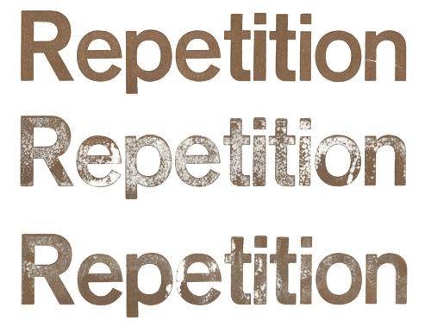
Designing Visual Documents
Contrast
Size
Color
Font
Repetition
Unity
Coherence
Consistency
Notes:
The principle of contrast allows the audience to distinguish important elements from the rest of the document. The most noticeable text stands out from the rest. Less noticeable elements are less important.
Repetition of specific visual or textual elements throughout the document serves to enhance coherence.
Repetition occurs in visual documents through bullets, colors, and fonts.
Consistencies in a visual document enforce a sense of unity.
Repetition of bullets serves to continue and unify a point.

Slide 11
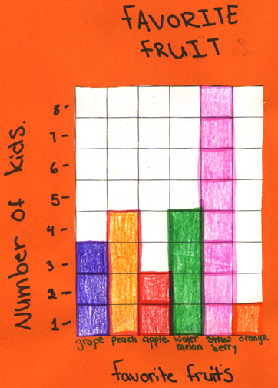
Combining Visual and Verbal
Supplement and reinforce
Clarify
Effective integration
“link them purposefully”
Proximity
Captions and labels
Notes:
Combining Visual and Verbal Elements
“When used together, words and images can supplement and reinforce to deliver a message…” (137)
Photos and text create a message in ads
Separately, words and images can be taken out of context
Together, they work to make an effective point in a brief amount of time
Graphics can clarify written material
“Graphics can be used to illustrate a concept, present data, provide visual relief, or simply attract readers’ attention.” (139)
“Tables organize data so that information can be easily accessed and compared.”
“Charts and graphs provide visual representations of data.”
I.e., can show “relationships of parts to a whole” (pie charts), relationships over time (line graphs), or “correlations between variables” (bar graphs)
Can also simplify otherwise complex/verbose concepts
Pictures illustrate the appearance of objects
Photos, sketches, technical illustrations, paintings, icons, and other visual representations
Visual and Verbal elements can be effectively integrated
“link them purposefully”:
“Proximity is a paramount consideration for effective integration.”
Relevance: do not include unnecessary or distracting elements
“Captions and labels also support visual and verbal integration…”
Clear, concise labels that “explain…relevance in the larger context of the work…”

Slide 12

Common Genres
Posters and flyers
Mass distribution
Capture attention
The “backward S”
Notes:
Common Genres and Effective Features of Visual Documents
“Posters and flyers quickly and easily reach a wide audience”
Poster: “usually employs much more visual than verbal…information so that its audience can absorb the message at a glance.” (146)
Flyers: “usually more text-heavy…intended for mass distribution…”
“need a focal point that captures attention and highlights the basic information.”
Balance between effective communication of the message without overwhelming the “reader”
Read with a “backward S” (147)
Tips for designing effective posters and flyers (148)
Identify your target audience
Determine your purpose
Consider where your poster will appear or how your flyer will be distributed
Provide a clear focal point
Aim for visual simplicity
Strive for coherence
Chunk information
Remember the backward S scanning pattern

Slide 13

Common Genres
Brochures and Newsletters
Specialized audience = more information
Headings and subheadings
Repetition
Other tools:
Pull Quotes
Sidebars
Notes:
Common Genres and Effective Features of Visual Documents
“Brochures and newsletters are strategically aimed at specialized audiences” (149)
“The audience has usually already indicated an interest in the topic by requesting the brochure or signing up for the newsletter.”
Brochures: “typically multipage, multicolored infomercials, printed on high-quality paper to advertise…often requested…rather than distributed indiscriminately.”
Not as time sensitive as a newsletter
Newsletter: “published regularly by an organization or group to update readers about activities and pertinent issues.”
Headings and subheadings provide an overview of contents and easy/quick/convenient access to specific information
Repetition of themes, symbols, colors, fonts, etc. provide unity
Other tools:
Pull quotes: “important phrases or sentences from the text reprinted in a way that contrasts with the body of the text” (152)
Sidebars: “shaded blocks of text containing supplementary information”
Tips for designing effective brochures and newsletters (153)
Identify your target audience and the appropriate genre
Design each page of the brochure or newsletter for ease of scanning (backward S)
Provide verbal and visual signposts for your readers: headings, subheadings, shading, and bullets
Use blocks or chunks of text to emphasize main points and include pull quotes and sidebars
Employ striking photographs and bold colors to contrast with black type

Slide 14
Outro: some thoughts
Relevance in today’s world (i.e., the Internet)
Competing interests all vying for your time
More effective visual documents enjoy the advantage
What is a good metric of “success” or “effectiveness”?
Being seen?
Communicating a point?
Altering behavior?
Dangers
Diluting the message/distracting “readers”
Appeals to emotion (most advertisements), etc., especially problematic when dealing with complex or controversial issues

Slide 15


Slide 16
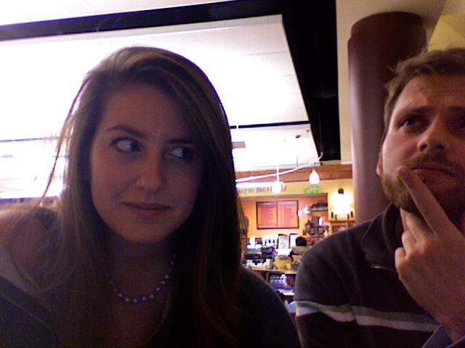
?

Slide 17
Citations
Images
http://www.merit.uiuc.edu/images/Merit-Student-Brochure-07-1.png
http://www.wasted-disk-space.com/2004/chicago0320/P3201011.jpg
http://images.google.com/imgres?imgurl=http://z.about.com/d/desktoppub/1/5/2/O/align-no.gif&imgrefurl=http://desktoppub.about.com/od/alignment/ss/alignment.htm&usg=__-0g5JuIWULUTXu0_trj77cmcrRY=&h=400&w=400&sz=23&hl=en&start=19&sig2=iTksoIp4P1KJpaHg1yno3Q&um=1&tbnid=k0Tkvvw6KvqgOM:&tbnh=124&tbnw=124&prev=/images%3Fq%3Dalignment%26hl%3Den%26safe%3Doff%26client%3Dsafari%26rls%3Den%26sa%3DG%26um%3D1&ei=ZlrVSoD7PIrBlAfe6eycCQ
http://z.about.com/d/psychology/1/5/D/1/proximity.jpg
http://www.presentationzen.com/.a/6a00d83451b64669e200e5545400818833-200wi
http://www.typeg.org/images/01_projects/40_repetition/06_repetition.jpg

